Slide 1
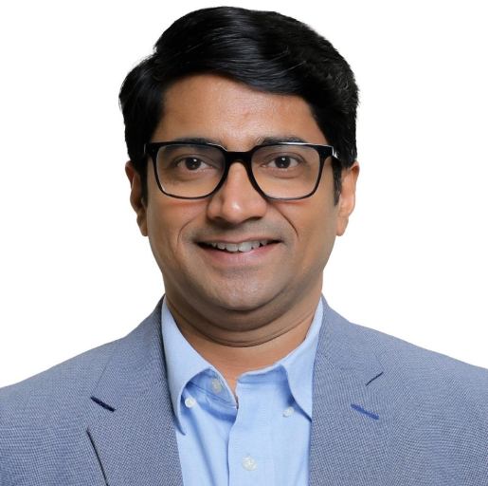
Profile
Member of the Managing Council and Administrative Board of S. P. Mandali Trust, Pune
Accomplished academic leader and management professional with extensive experience in higher education and institutional development
Actively drives global engagement, fostering collaborations with international universities, consulates, and professional bodies
Frequently participates in national and international conferences, policy dialogues, and professional forums
Committed to enhancing institutional visibility and enabling sustainable development in management education
Accolades
National Assessment and Accreditation Council (NAAC) approved Assessor
Recipient of Gansu International Fellowship Program (GIFP)
FDPM from Indian Institute of Management (IIM), Ahmedabad
Cleared Civil services UPSC (IAS) prelims and mains examination the year 2000
Prof. Dr. Pankaj Natu
Director - MMS, WeSchool
Ph.D. Students Graduated under his guidance-4
Journal papers/ Conference papers and Articles-35
Books/Chapters/Case Studies – 7
Patents - 4

